Slide 1
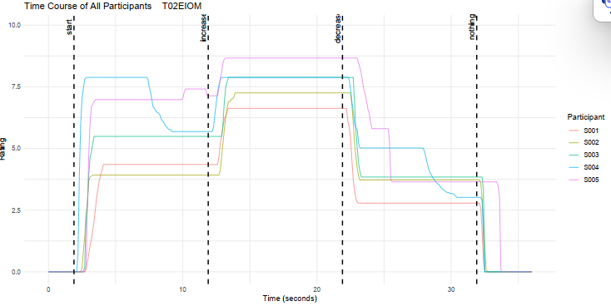
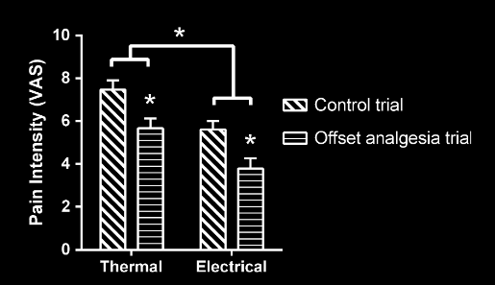
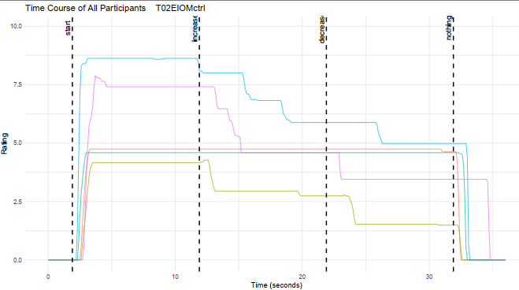
23s
27s
Quantification of the OA effect.
Calculate the mean of VAS rating in the time window from 1s-5s after the cessation of the offset.
4s
2s
12s
22s
32s

Slide 2
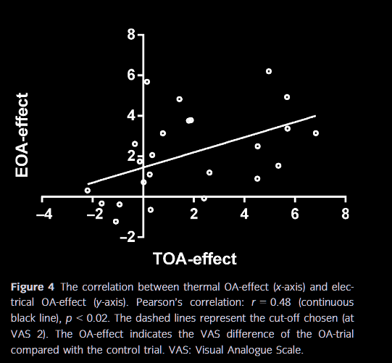

Slide 3
The VAS scores were averaged across the two arms. The term ‘OA-effect’ was chosen to indicate the VAS difference of the OA-trial compared with the control trial. The OA-effect is present after the decrease in the painful stimulus from STIM2 to STIM3; therefore, the mean VAS score from 1 to 5 s after the onset of the STIM3 interval was used to analyse the OA-effect. This corresponds to 16–20 s into the thermal trials (due to the delay of the thermodes to reach the target temperatures and the latency of the response) and 13–17 s into the electrical trials (Fig. 2). Initially, a three-way rmANOVA was applied to investigate the difference in pain ratings during the OA-response with modalities (thermal, electrical) and trials (control, OA) as within-subject factors (SPSS 24.0, IBM Corporation, New York, USA). Bonferroni adjusted post hoc was applied to adjust for multiple comparisons. Secondly, the OA-effect was calculated as the difference in the pain ratings between the control and the OA-trials. Finally, Pearson’s correlation was applied to investigate any potential relation between the thermal and electrical OA-effects and a frequency analysis were conducted to investigate thermal and electrical OA-effect above 0 using a chisquare test. p-values less than 0.05 were considered significant. In the text and figures, data are presented as mean standard error of mean (SEM).
From paper

